Slide 1
Mohamed Amjad. A
Final Project
3/21/2024 Annual Review

Slide 2
PROJECT TITLE
Text style transfer with conditional generative models and attention mechanisms
3/21/2024 Annual Review

Slide 3


AGENDA
Problem Statement
Project Overview
The solution
The value proposition
Modelling
Result
3/21/2024 Annual Review

Slide 4

PROBLEM STATEMENT
The problem statement for text style transfer with conditional generation and attention revolves around the challenge of developing neural network models capable of altering the style of a given text while preserving its content. This entails training models on paired datasets of texts in different styles and incorporating conditional generation and attention mechanisms to ensure accurate style transfer. The objective is to create a system that can generate text with a desired style while maintaining the semantic meaning and coherence of the original content.
3/21/2024 Annual Review

Slide 5

PROJECT OVERVIEW
Our project focuses on text style transfer, employing cutting-edge techniques in natural language processing (NLP). By harnessing neural network architectures with conditional generation and attention mechanisms, we endeavor to alter the style of input text while preserving its semantic content. Through meticulous data preprocessing and model training on paired datasets containing diverse styles, we aim to achieve accurate and nuanced style transfer. Our objective is to develop a robust system capable of generating text with desired styles, catering to applications in content generation, translation, and paraphrasing.
3/21/2024 Annual Review

Slide 6

WHO ARE THE END USERS?
1. Content Creators: Writers, bloggers, marketers, and social media influencers seeking to generate content in various styles to engage with their audience more effectively. For instance, a marketing agency might use text style transfer to tailor their messaging to different demographics, ensuring that their content resonates with each target audience.
2. Translators: Professionals or individuals looking to translate text while preserving the style or tone of the original content. For example, a literary translator may use text style transfer to maintain the unique voice and cultural nuances of a piece of literature while translating it into another language, ensuring that the translated work captures the essence of the original.
3/21/2024 Annual Review

Slide 7

YOUR SOLUTION AND ITS VALUE PROPOSITION
Our solution offers an advanced neural network model for text style transfer, incorporating conditional generation and attention mechanisms to accurately modify the style of input text while preserving its semantic meaning. This efficient and versatile tool caters to a wide range of users, including content creators, translators, and businesses, providing them with a seamless way to customize text styles to suit their specific needs. With its ability to enhance engagement, preserve cultural nuances, and push the boundaries of NLP innovation, our solution represents a valuable asset for those seeking to generate compelling and tailored content.
3/21/2024 Annual Review

Slide 8

THE WOW IN YOUR SOLUTION
In our solution, we introduce a groundbreaking approach to text style transfer that not only accurately adjusts the style of input text but does so with unparalleled precision and efficiency. By seamlessly integrating conditional generation and attention mechanisms, our model achieves a level of sophistication that surpasses conventional methods, enabling users to effortlessly transform text while retaining its original meaning and coherence. This innovation not only revolutionizes the way content is created and translated but also opens up new possibilities for personalized communication and cultural preservation. With its ability to push the boundaries of what's possible in natural language processing, our solution stands as a testament to the transformative power of cutting-edge technology in shaping the future of communication.
3/21/2024 Annual Review

Slide 9
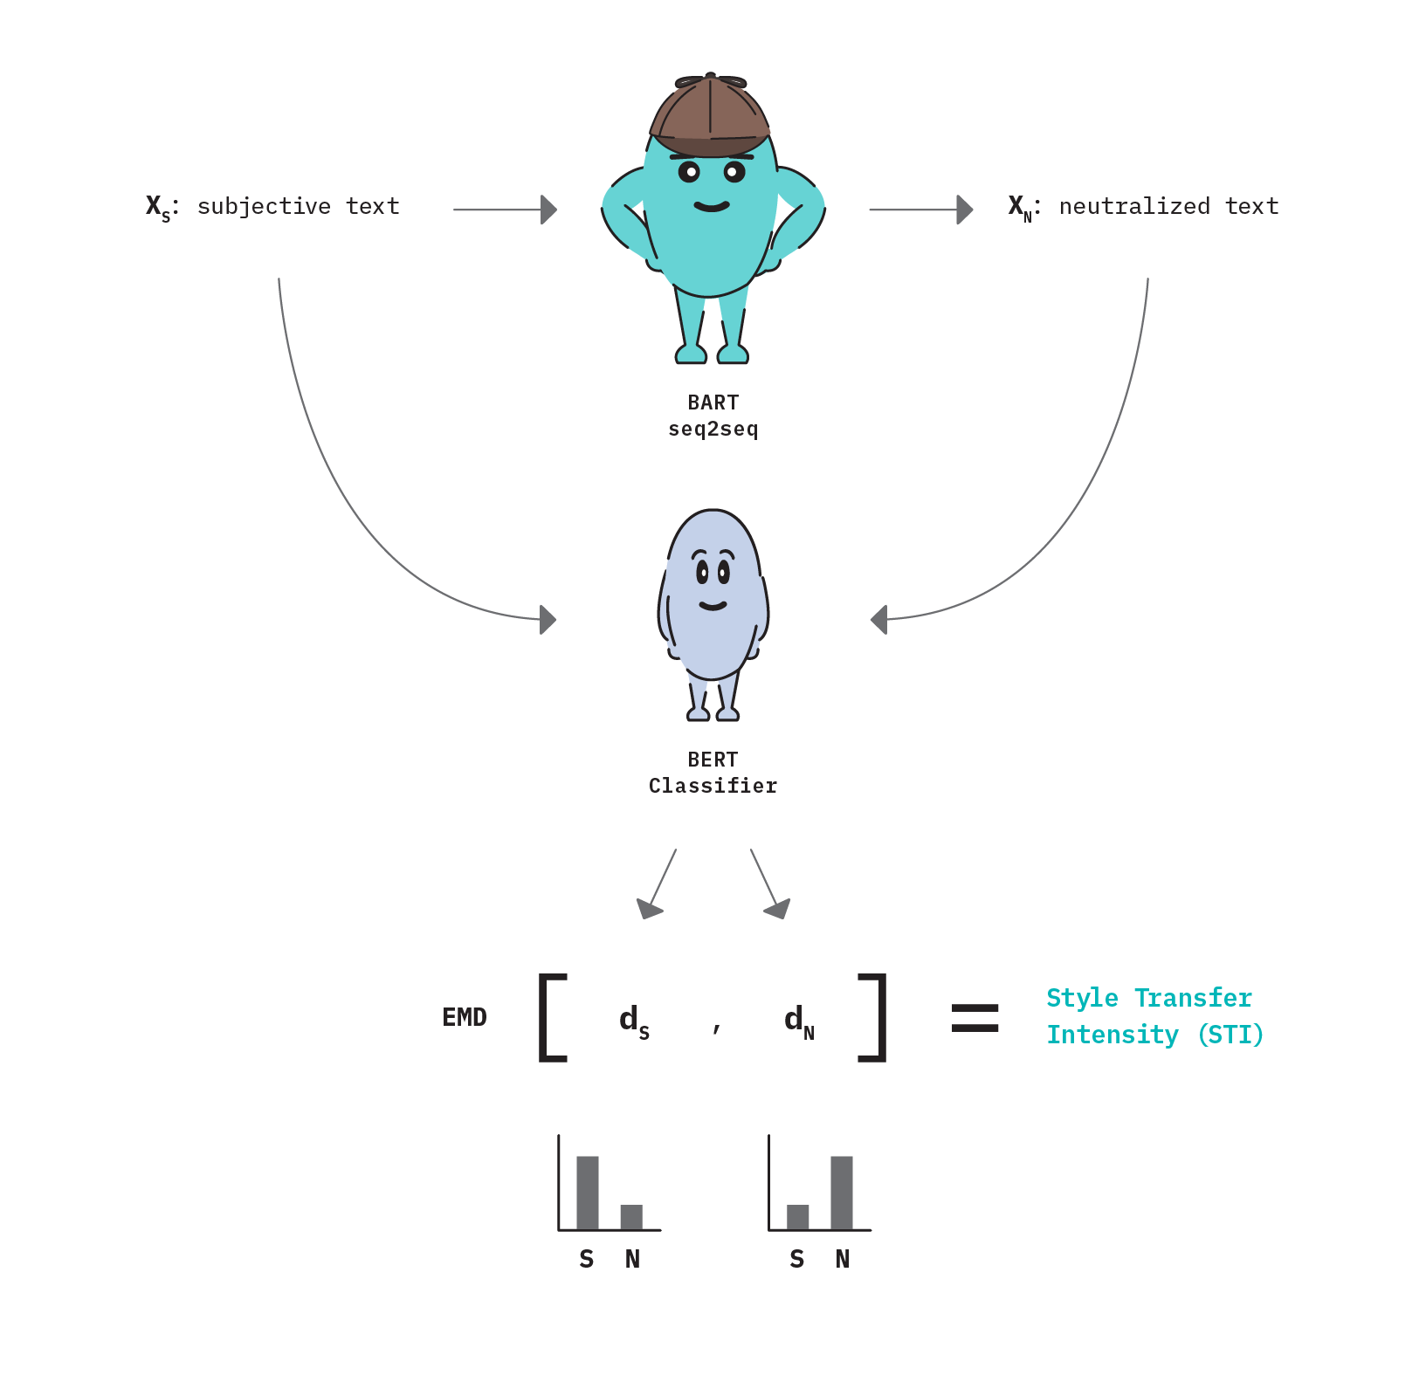
MODELLING
Teams cam add wireframes
3/21/2024 Annual Review

Slide 10
RESULTS
The result of our solution is a highly accurate and versatile text style transfer model that seamlessly adjusts the style of input text while preserving its semantic content. Through meticulous training and optimization, our model achieves remarkable precision in style transfer, allowing users to effortlessly generate text in various styles tailored to their specific needs. Whether it's crafting engaging marketing content, translating literature while maintaining its unique voice, or personalizing communication for diverse audiences, our solution delivers exceptional results that exceed expectations. With its ability to enhance engagement, streamline workflows, and unlock new possibilities in language customization, our model represents a significant advancement in the field of natural language processing, promising transformative impact across a wide range of applications.
3/21/2024 Annual Review

